Slide 1
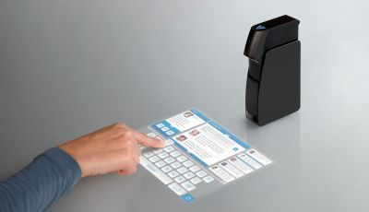
Turn any Normal Screen into Touch Screen
Project Partner:
Tushar G. Ubarhande(1821028)
Dinesh K. Katakamwad(1821016)
Jaykumar A.Pawar(1821024)
Sumeet D Dongardive(1821011)

Slide 2
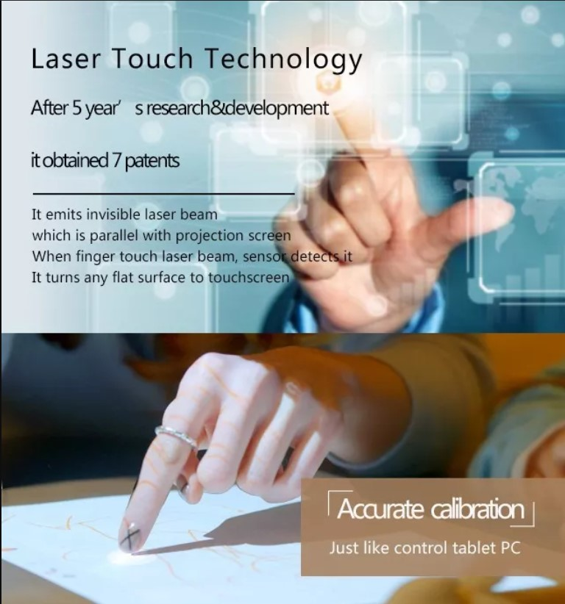
Introduction
Touch Screen are a very attractive and effective way that helps people in their everyday activities, in this project a way to produce touch and normal ( i. e. touch less screen ) is introduced.
This technology most widely used in computers, user interactive machines, smartphones, tablets, etc to replace most functions of the mouse and keyboard.

Slide 3
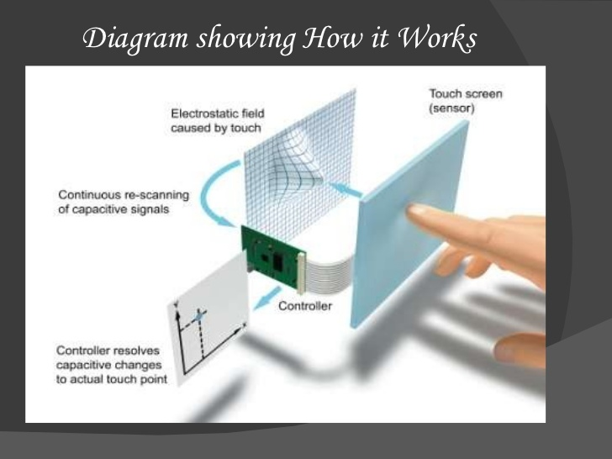
Touch Screen Technologies
Capacitive Plates

Slide 4
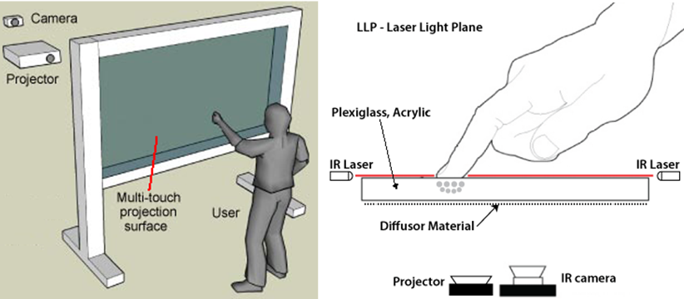
Touch screen Technologies
IR LED plate with PS3 move.

Slide 5
Main Objectives
1- Introduce a new technology that will help in making touch surface available in our country.
2- Produce a low cost system that can replace the traditional expensive touch screen system.
3- Improve people knowledge in how modern technology used in many modern devices can be used to others purpose that make everyday life easier.

Slide 6
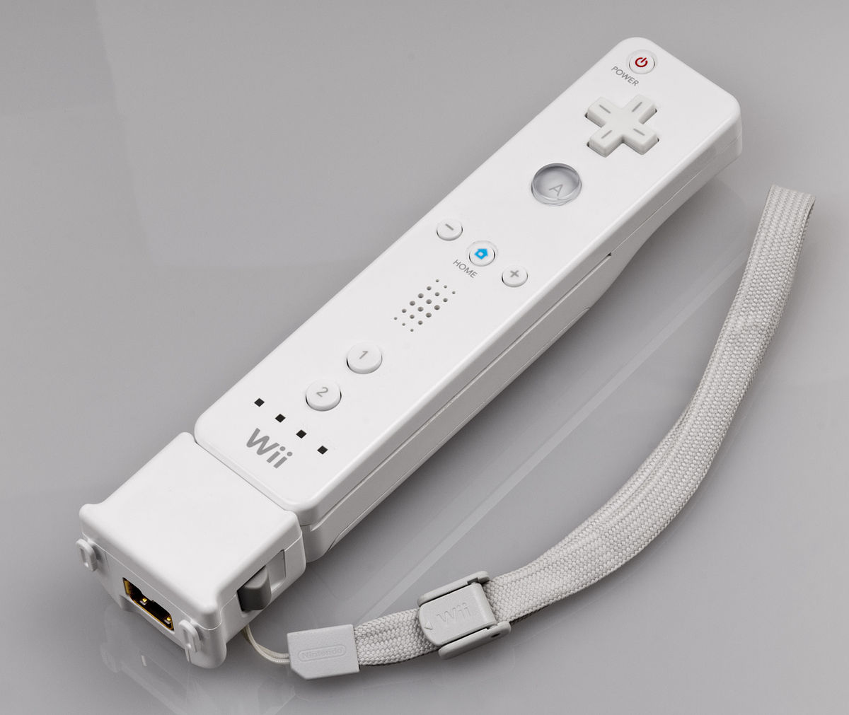
Idea
Since the remote can track sources of infrared ( IR ) light, it can track pens that have an IR led in the tip. By pointing a Wii remote at a projecting screen or LCD display, we can create very low cost interactive whiteboard or tablet displays. Since the remote can track up to 4 points, up to pens can be used.

Slide 7
Main Components
1- IR Pen.
2- IR Detector( Wii remote ).
3- Calibration Software.
4- Screen or Surface connected to PC.

Slide 8
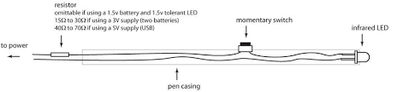
IR Pen
IR Pen is used to send infrared light, the IR fer Detector will then receive this light beams and transfer it’s position to PC using Bluetooth, after a PC program will make movements in the screen according to where the IR Beam was seen.

Slide 9
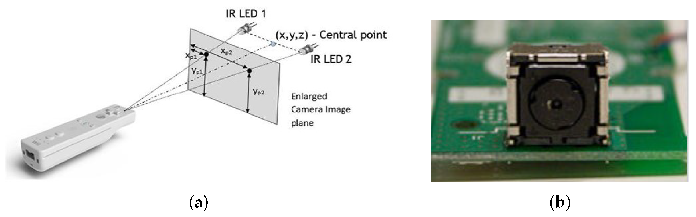
IR Detector
Wii remote contain many components, but the components of interest in this project are IR detector in the front of Wii remote and the Bluetooth module which is used to transmit data between PC and Wii IR Detector.

Slide 10
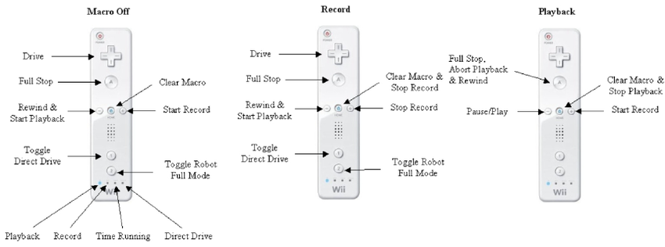
Working of Wii Remote

Slide 11
Calibration Software
The software that is used in this project is written in C# language under visual basic Studio environment, it’s main purpose is to calibrate the dimensions of the screen that will be converted to touch by four points calibration and receive data from Wii remote and process it in the operating system screen as action such as ( mouse click, mouse moves, opening documents…etc. ).

Slide 12
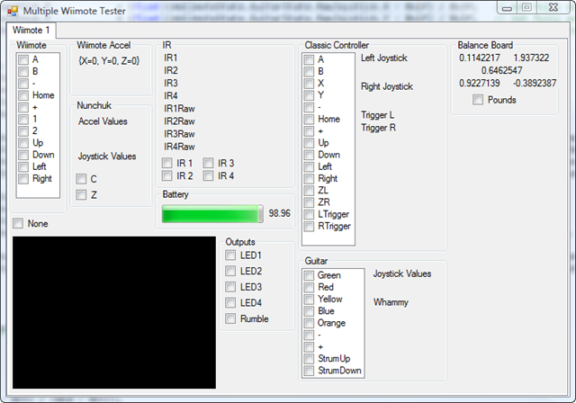
Actual Calibration

Slide 13
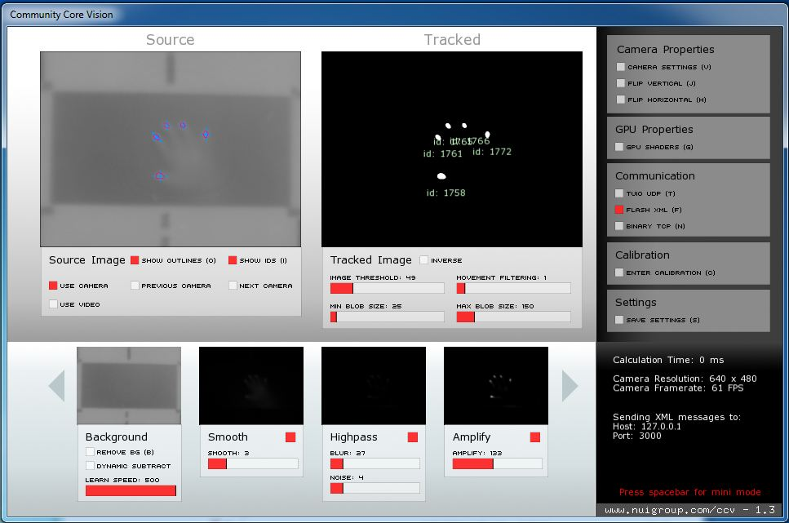
Demo of Calibration

Slide 14
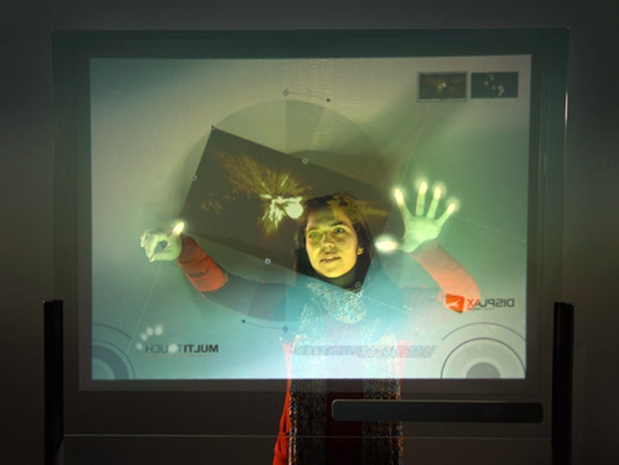
Screen or Surface connected to PC
The main idea of this project is to convert any screen or surface to interactive touch surface , so Screen or flat surface are required to be used as display to what we want to show and convert into touch

Slide 15
Steps To do The Converting
Connect Wii remote to PC via Bluetooth,
Place Wii remote in such way that it sees all the light that comes out from the pen, with no obstacle or blockers around.
Run the Wii remote Whiteboard sample program ( that is attached in the appendix. ) Make sure Wii remote is connected via Bluetooth, and then “.exe” in the main folder.
Press the A Letter in the Wii remote or click the Calibration button in the software.
Calibrate the 4 points correctly and then the touch screen is good to go.

Slide 16
Code
1. Libraries:
using System.Runtime.InteropServices; // For firing keyboard and mouse events ( optional )
using System.IO; // for saving the reading the calibration data
using wiimoteiib; // Wii remote library for dealing with the wii function and buttons within the code

Slide 17
Code
2- Screen default and calibration:
int screenwidth = 1024;
int screenHight = 768; // default, gets replace by actual screen size
int calibrationState = 0;
float calibrationMargin = .1f; // for calibrating the margin around the screen

Slide 18
Code
3- Wii Remote
// connect to Wii remote
wm.Connect();
// set wii remote LED’s with this enumerated ID
wm.SetLED’s( true, false, false );
// disconnect the wiimote
wm.Disconnect();
saveCalibretionData();

Slide 19
Code
4- Do Calibration
To show the 4 points calibration;
public void doCalibretion(){
if ( cf == null )
return;
int x = 0;
int y = 0;
int size = 25;
Pen p = new Pen( colour.Red );

Slide 20
Code
switch ( calibrationState )
{
case 1:
x = ( int ) ( screenwidth * calibrationMargin );
y = ( int ) ( screenHight * calibrationMargin );
cf . showCalibration ( x, y, size, p );
dstX[ calibrationState - 1 ] = x;
dstX[ calibrationState - 1 ] = y;
break;

Slide 21
Thank-You….

